Slide 1
Objectives
You will be able to ...
define data that can hold a collection of as many items as you want.

Slide 2
Do Now
What types of data have we worked with so far?

Slide 3
Review
What types of data have we worked with so far?
numbers, strings, images, booleans

Slide 4
5

Slide 5
What is it? What can you do with it?
“hello”

Slide 6
What is it? What can you do with it?
true

Slide 7
What can you do with it?
Email

Slide 8
Review
What types of data have we worked with so far?
numbers, strings, images, booleans
Atomic Data

Slide 9
Review
What types of data have we worked with so far?
numbers, strings, images, booleans
worlds, students, sneakers, boas, tigers, dillos, sneakers
Notes:
What did these data types have in common?

Slide 10
Review
What types of data have we worked with so far?
numbers, strings, images, booleans
worlds, students, sneakers, boas, tigers, dillos, sneakers
Compound Data

Slide 11
Review
What types of data have we worked with so far?
numbers, strings, images, booleans
worlds, students, sneakers, boas, tigers, dillos, sneakers
Atomic Data
Compound Data
Notes:
What do all of these types of data have in common?

Slide 12
Review
All the data we have worked with had an exact size.
numbers, strings, images, booleans
worlds, students, sneakers, boas, tigers, dillos, sneakers
Fixed Size Data

Slide 13
Functions with Fixed Size Data
We used a design recipe to write functions using fixed sized data. Now we’re going to learn to design functions using any size data!

Slide 14
Arbitrary Size Data
To represent data when we don’t know how many items there are.

Slide 15
Arbitrary Size Data
To represent data when we don’t know how many items there are.
Examples: contacts, playlists, online shopping carts, rapid fire projectiles

Slide 16
Arbitrary Size Data
Simplest arbitrary size data is a list

Slide 17
Arbitrary Size Data
Simplest arbitrary size data is a list
What is the most simple list?
Notes:
What is the most simple list?

Slide 18
Empty Lists
Simplest arbitrary size data is a list
The simplest list is empty
Notes:
Show empty in Pyret

Slide 19
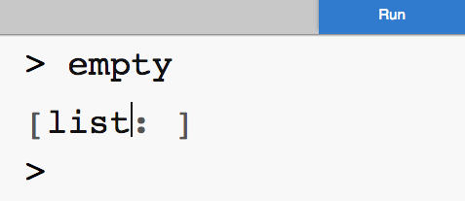
Empty Lists
empty is a value that stands for a list with nothing in it
Notes:
What is the next most simple list?

Slide 20
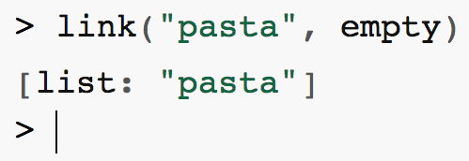
Lists are links of data
How to create a list of Mr. Allatta’s favorite foods
Notes:
What is the next most simple list?

Slide 21
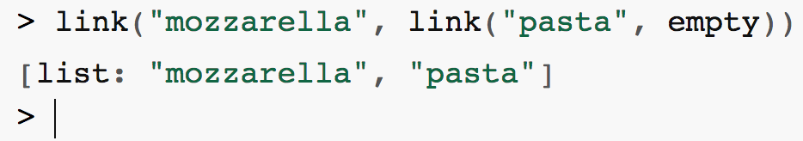
We can add as many things as we want
Let’s add one more
Notes:
What is the next most simple list?

Slide 22
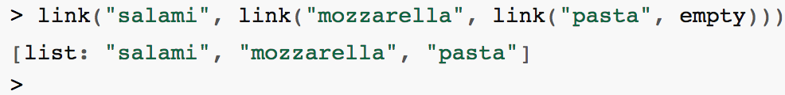
We can add as many things as we want
Links of links of links!
Notes:
What is the next most simple list?

Slide 23
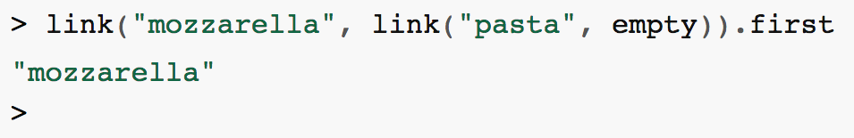
Getting items from a list
We can get the first item from the list
Notes:
What do you think this expression will return?

Slide 24
Getting items from a list
We can get the first item from the list
Notes:
What do you think this expression will return?

Slide 25
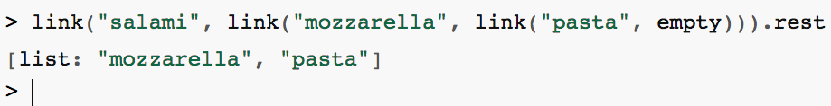
Getting items from a list
We can get the rest of the items from the list
Notes:
What do you think this expression will return?

Slide 26
Getting items from a list
We can get the rest of the items from the list
Notes:
What do you think this expression will return?

Slide 27
Data can be defined recursively
data List:
| empty
| link(item, a-list :: List)
end

